Slide 1


Machine Learning Model Selection For Cars And Heart Dataset
by Gaurav Kumar Singh

Slide 2
KEY COMPONENTS
Data
Algorithm
Model

Slide 3

Importance of Choosing the Right Model
Model selection is crucial for achieving accurate predictions and insights. The wrong model can lead to poor performance and inaccurate results.
Accuracy
Efficiency
Choosing the right model can ensure the model's predictions are accurate and reliable.
The right model can be optimized to achieve the desired accuracy without sacrificing processing time.
Interpretability
Some models are more interpretable than others, making it easier to understand the reasoning behind the model's decisions.

Slide 4
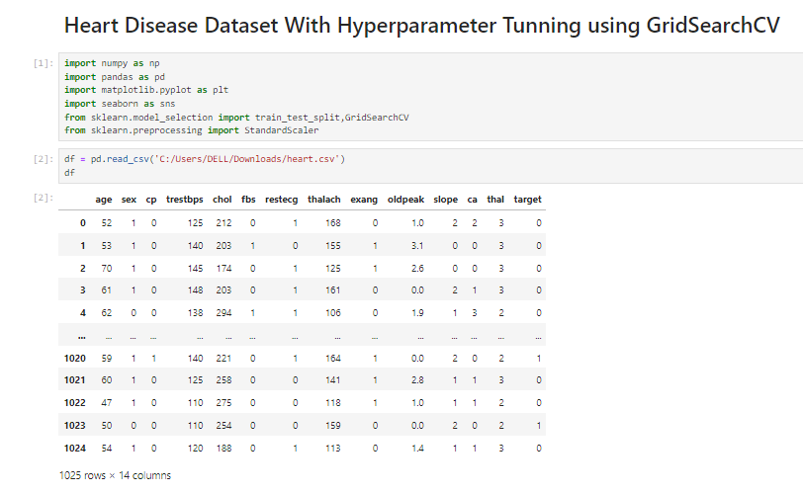
HEART DATASET – TARGET COLUMN IS CATEGORICAL
Library Needed
CATEGORICAL COLUMN

Slide 5
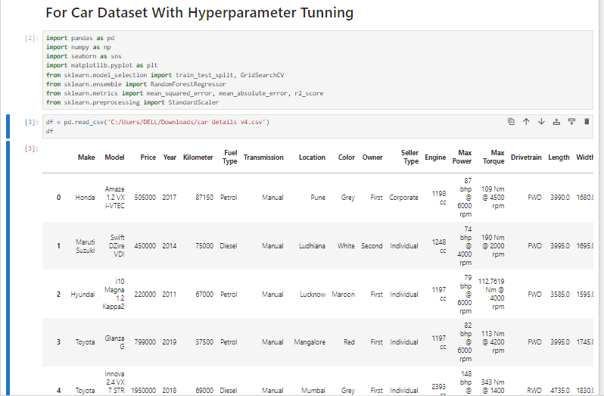
CARS DATASET – PRICE COLUMN IS NUMERICAL
Library Needed
NUMERICAL COLUMN

Slide 6

Exploratory Data Analysis (EDA)
EDA involves analyzing and visualizing your data to gain insights, identify patterns, and detect any outliers or issues. It guides your model selection.
1
Data Preprocessing
2
Data Visualization
3
Data analysis

Slide 7
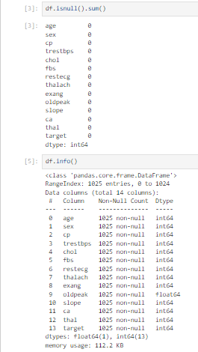
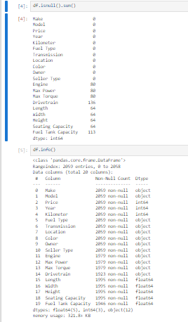
CHECKING FOR MISSING VALUE IN HEART AS WELL AS CARS DATASET
FOR HEART DATASET
FOR CARS DATASET

Slide 8
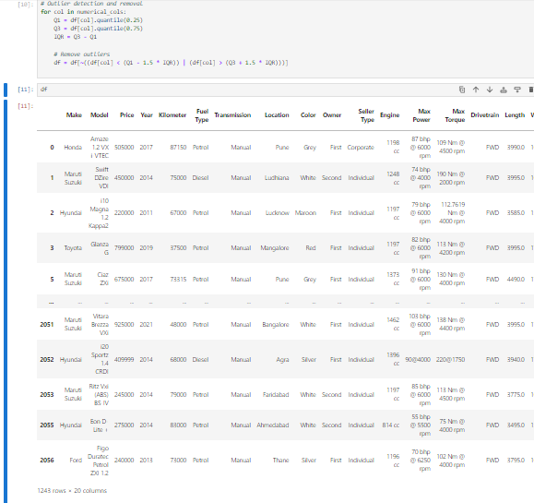
OUTLIER DETECTION & REMOVAL (CARS DATASET)

Slide 9
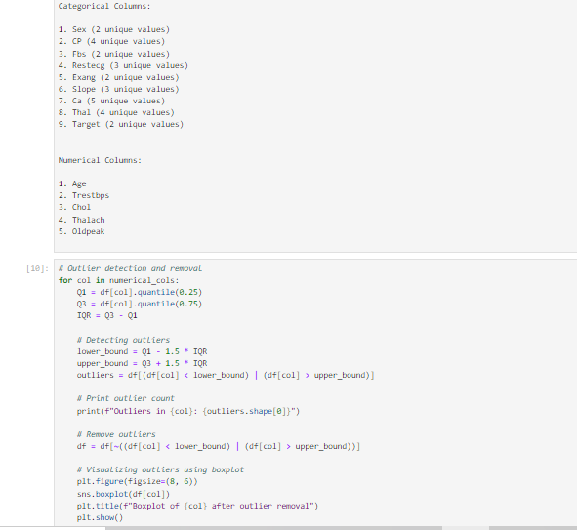
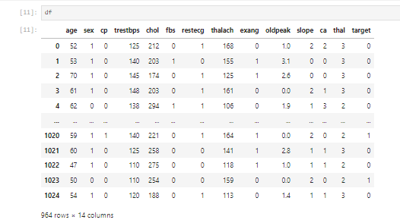
OUTLIER DETECTION & REMOVAL (HEART DATASET)

Slide 10
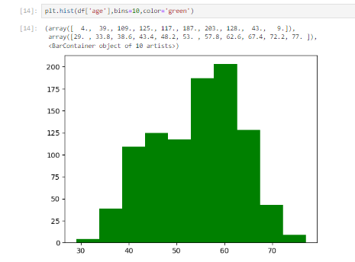
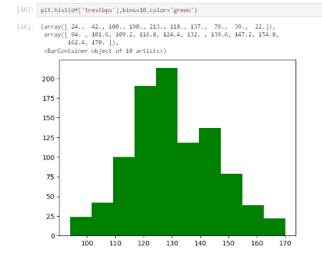
UNIVARIATE ANALYSIS (HEART DATASET)

Slide 11
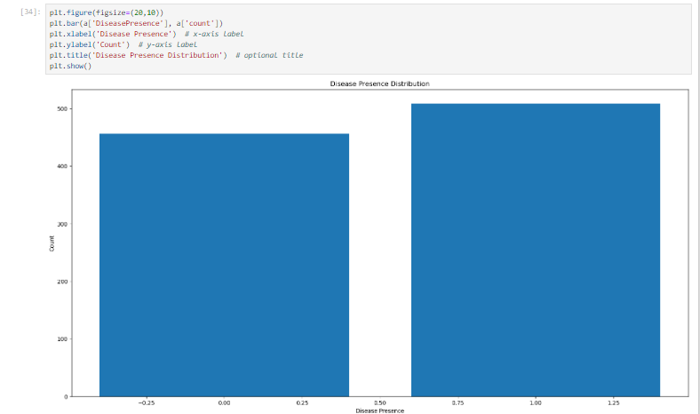
BAR GRAPH ON DISEASE PRESENT (HEART DATASET)

Slide 12
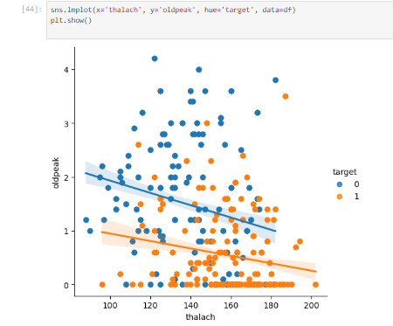
BIVARIATE ANALYSIS (HEART DATASET)

Slide 13
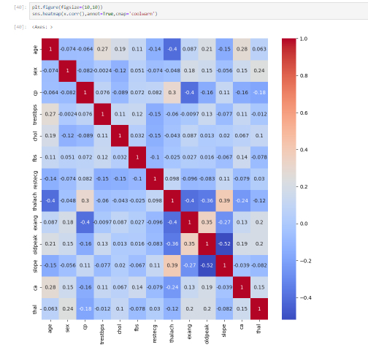
MULTIVARIATE ANALYSIS (HEART DATASET)-HEATMAP

Slide 14
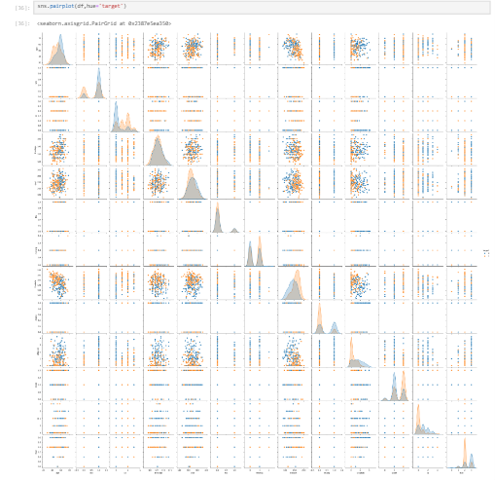
PAIRPLOT(HEART DATASET)

Slide 15
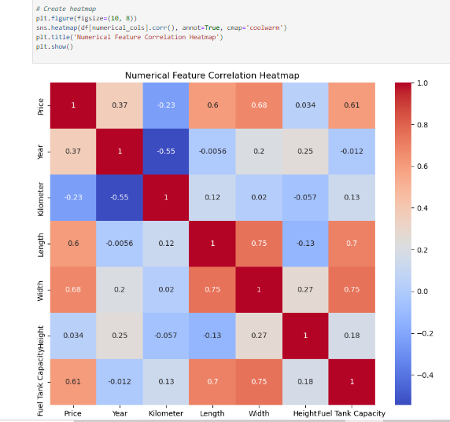
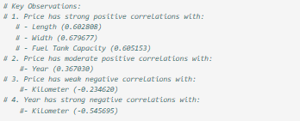
MULTIVARIATE ANALYSIS (CARS DATASET)-HEATMAP

Slide 16
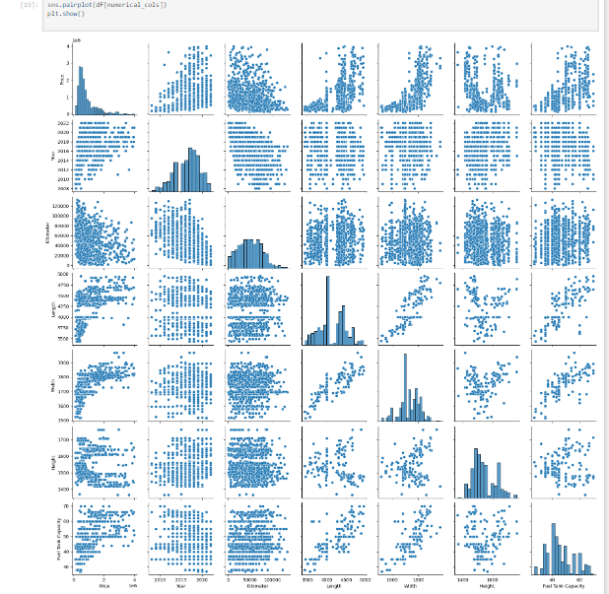
PAIRPLOT(CAR DATASET)

Slide 17
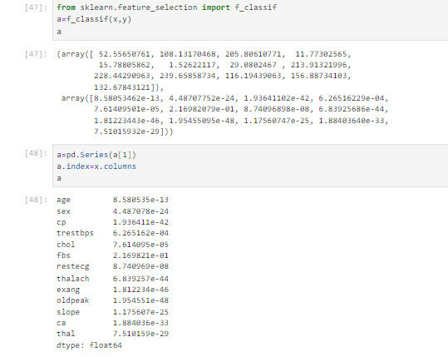
ANOVA TESTING (HEART DATASET)

Slide 18





Evaluating Model Performance
Model evaluation involves assessing the performance of a model using different metrics. Common metrics include accuracy, precision, recall, and F1-score.
Accuracy
Precision
The proportion of correctly classified instances.
The proportion of correctly predicted positive instances among all positive predictions.
Recall
F1-Score
The proportion of correctly predicted positive instances among all actual positive instances.
The harmonic mean of precision and recall, providing a balanced measure.

Slide 19

Hyperparameter Tuning and Model Optimization
Hyperparameter tuning involves adjusting the model's parameters to optimize its performance. Techniques like grid search and random search can be employed.
1
Grid Search
2
Random Search
Exhaustively evaluates different combinations of hyperparameter values.
Randomly samples hyperparameter values, often more efficient than grid search.
3
Cross-Validation
Divides the data into folds, training and evaluating the model on different subsets.

Slide 20
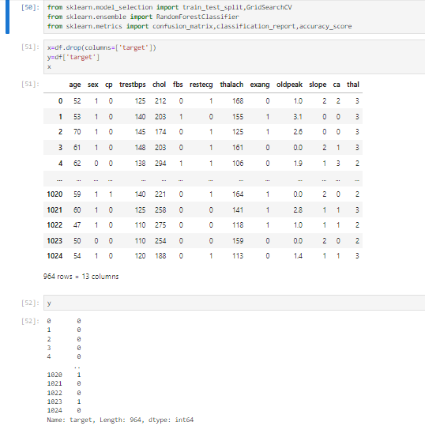
MODEL TRAINING (HEART DATASET)

Slide 21
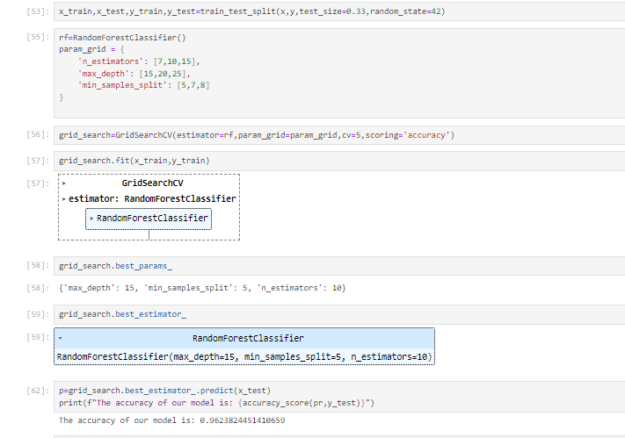
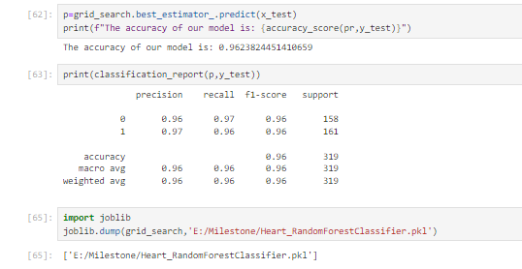
MODEL TRAINING (HEART DATASET)

Slide 22
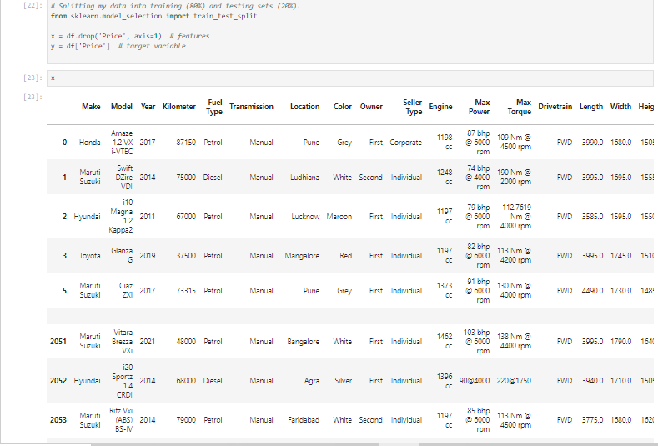
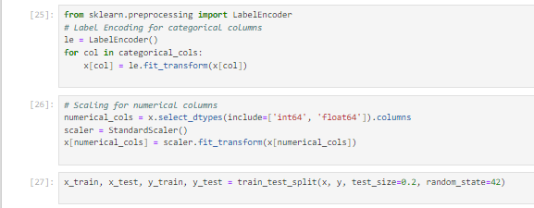
MODEL TRAINING (CAR DATASET)

Slide 23
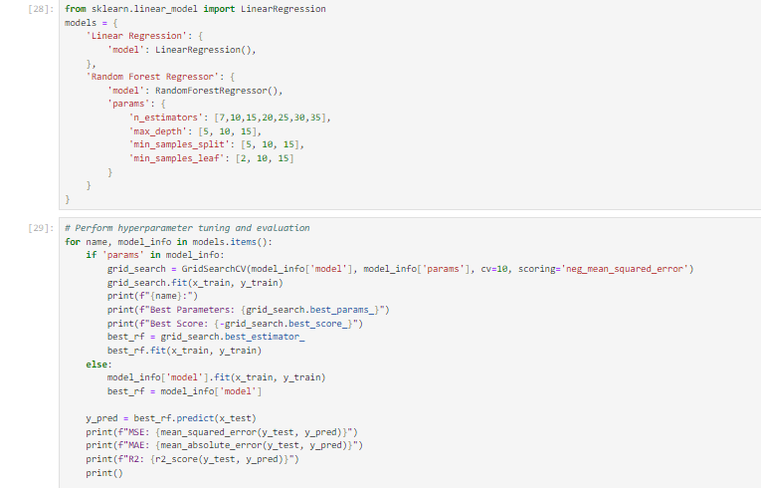
MODEL TRAINING (CAR DATASET)

Slide 24
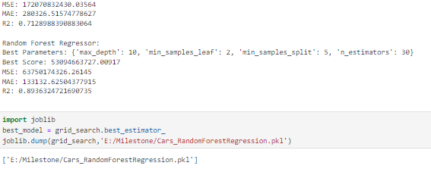
MODEL TRAINING (CAR DATASET)

Slide 25

Conclusion
Model selection is an iterative process that requires understanding your data, choosing appropriate algorithms, evaluating performance, and optimizing parameters.
Experiment
Iterate
I Tried different models, features, and hyperparameters to find the best solution for my problem.
I Continuously evaluated and improved my model as I gain more data and insights.
Deploy
Once I am satisfied with my model's performance, I deployed it for real-world use.

Slide 26
THANK YOU

